Slide 1

Generative models: theory and algorithms
Group Members:
昌珺涵 1700011741 宁顺磊 1901210052
吴思琪 1901220006 柴劲航 1700010678 聂涵韬1700010679
March 18, 2020

Slide 2

What is generative models?
Models learning the joint distributions of understand complex, unstructured data.
Discriminative vs. Generative
What do we want to do by a generative model?
Density estimation
Data completion (image/audio super resolution)
Data generation
Unsupervised representation learning
Etc.
How to construct?
First question: how do we model the joint distribution of many random variables?
Second: how to learn it?

Slide 3
CONTENT
• Fully observed likelihood-based models
• Autoregressive
• Flow-based models
• Latent variable models
• Variational autoencoder
• Combinations of basic models
• Implicit generative models—Generative Adversarial Networks
• GAN and its variants
• Property of GAN: convergence, stability and robustness

Slide 4
Autoregressive Models
Using Chain Rule to represent joint distribution:
How to parameterize the conditional distribution?
General parametric model such as logistic regression needs too much parameters on a high dimension dataset.
Neural Networks! (more flexible and more model capacity)
Models:
NADE(Tie weights to reduce the number of parameters and speed up computation)
MADE: Masked Autoregressive density estimator(use masks to disallow certain paths)
Pixel RNN and Pixel CNN(van den Oord, 2016)

Slide 5
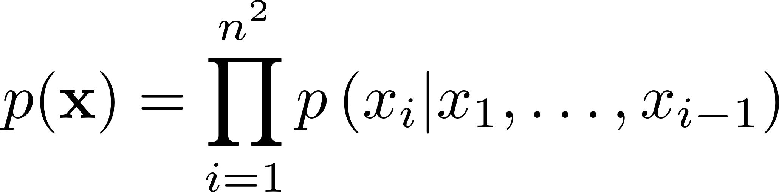
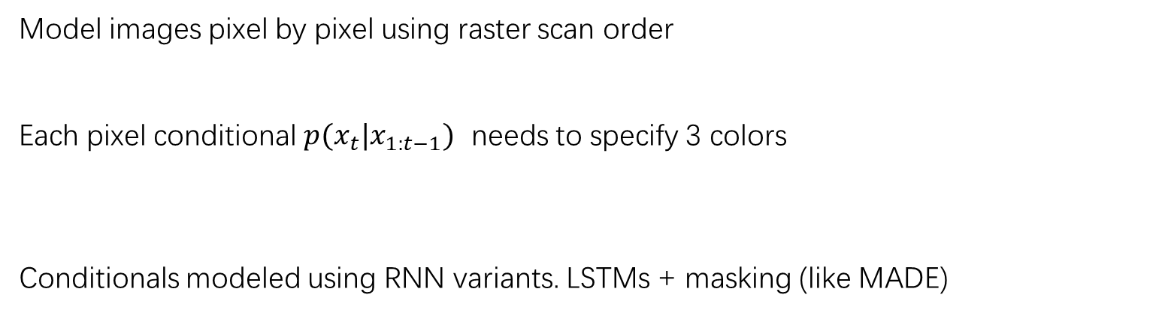
Pixel RNN
Model images pixel by pixel using raster scan order
Each pixel conditional $p(x_{t}|x_{1:t−1})$ needs to specify 3 colors
Conditionals modeled using RNN variants. LSTMs + masking (like MADE)

Slide 6
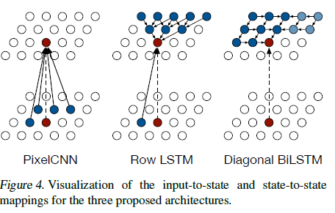
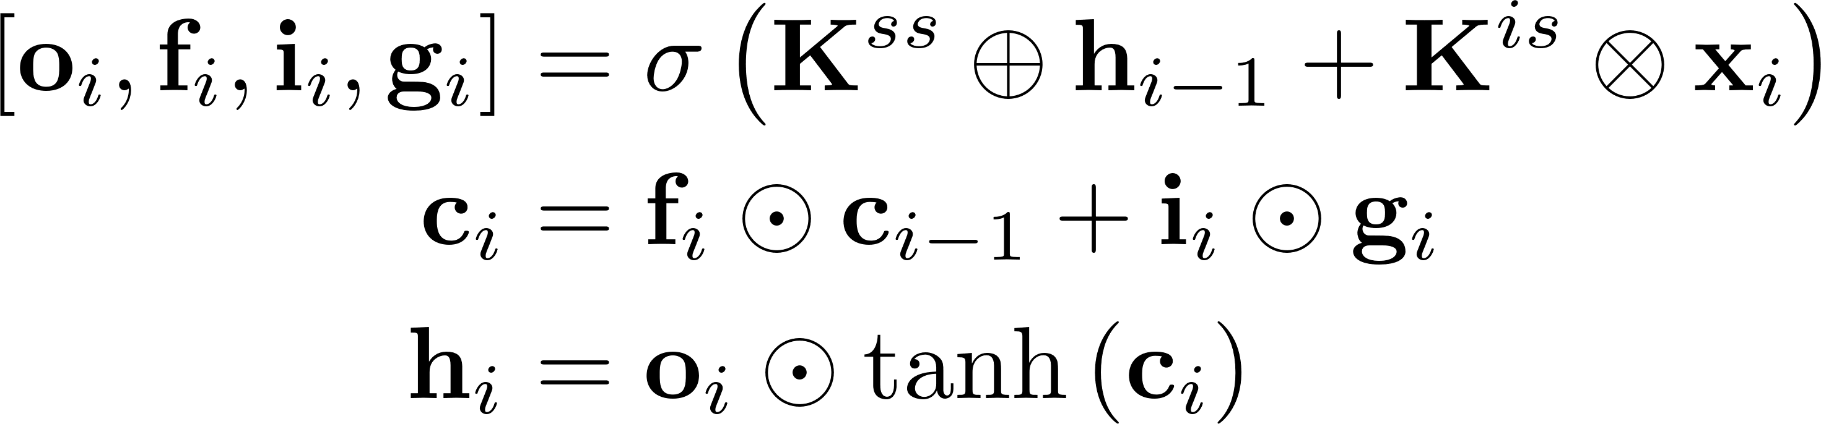
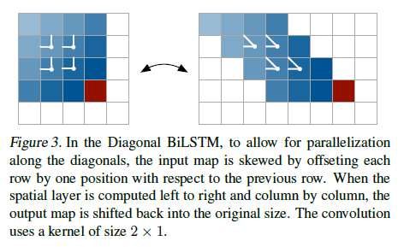
Row LSTM
Processes the image row by row from top to bottom computing
features for a whole row at once with a one-dimensional convolution.
The weight sharing in the convolution ensures translation
invariance of the computed features along each row.
Diagonal BiLSTM
The Diagonal BiLSTM is designed to both parallelize the
computation and to capture the entire available context for
any image size.

Slide 7
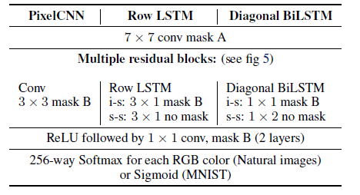
Pixel CNN
The Row and Diagonal LSTM layers have a potentially unbounded
dependency range within their receptive field. This comes with a
computational cost as each state needs to be computed sequentially.
The Pixel CNN uses masked convolutional layers to capture a bounded
receptive field and compute features for all pixel positions at once.
Achieve parallelization during training and evaluating test images;
The image generation process is still sequential.
Details of the architectures. In the LSTM architectures i-s and s-s stand for input-state and state-state convolutions.

Slide 8
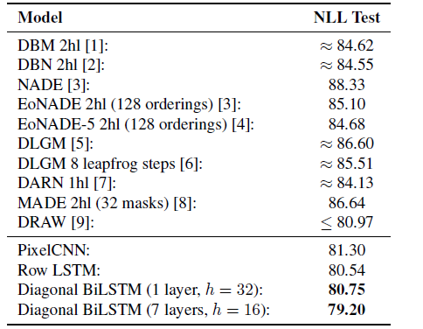
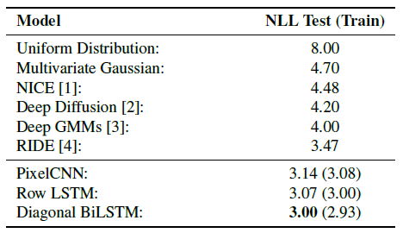
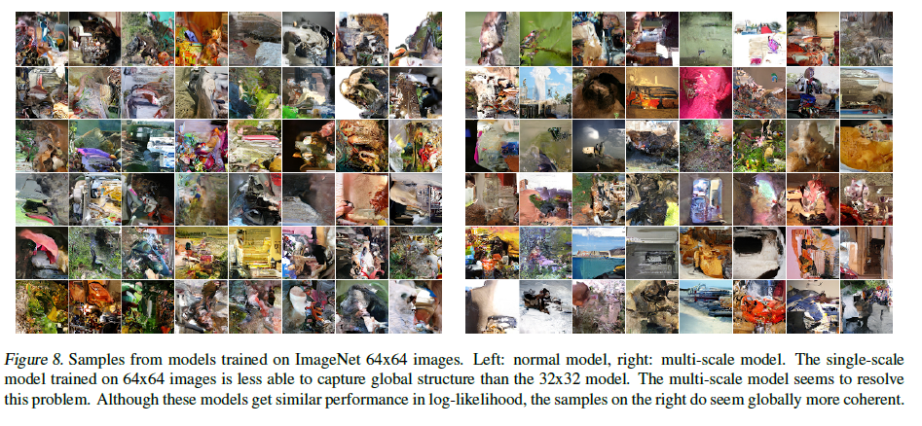
Experiments and Results
Test set performance of different models on CIFAR-10 in
bits/dim.
Test set performance of different models on MNIST in nats (negative log-likelihood).

Slide 9
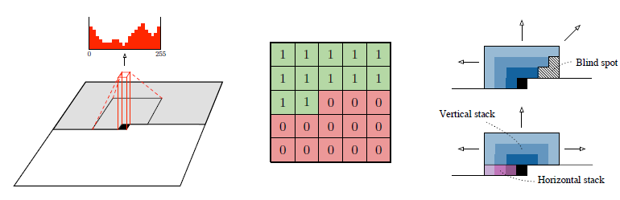
Gated Pixel CNN
Pixel RNN outforms Pixel CNNs as generative model:
the recurrent connections in LSTM allow every layer in the network to access the entire neighborhood of previous pixels, while the region of the neighborhood available to pixel CNN grows linearly with the depth of the convolutional stack.
Pixel RNNs contain multiplicative units (in the form of the LSTM gates), which may help it to model more complex interactions.
To amend this we replaced the rectified linear units between the masked convolutions in
the original Pixel CNN with the following gated activation unit:

Slide 10
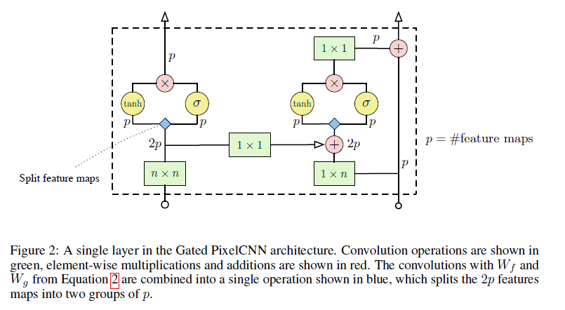
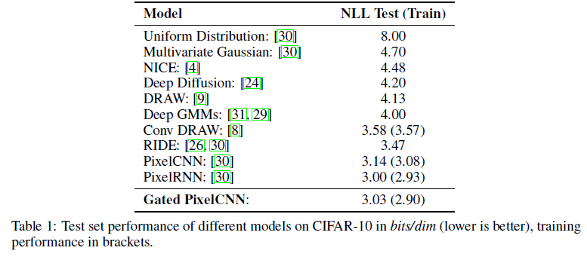
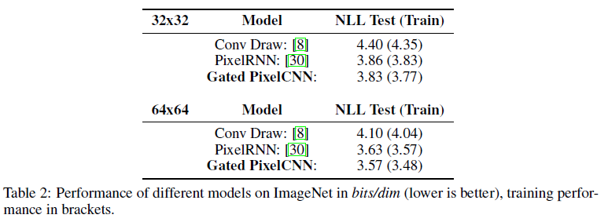
Gated Pixel CNN

Slide 11
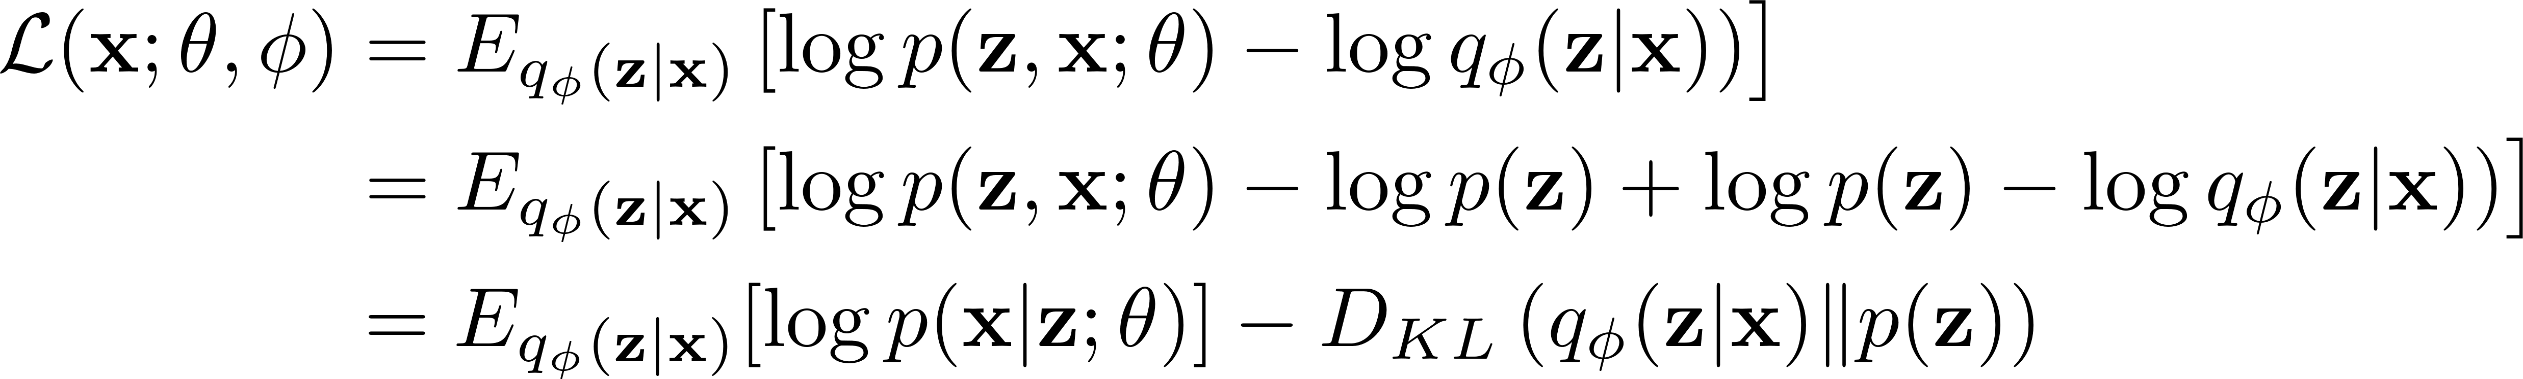
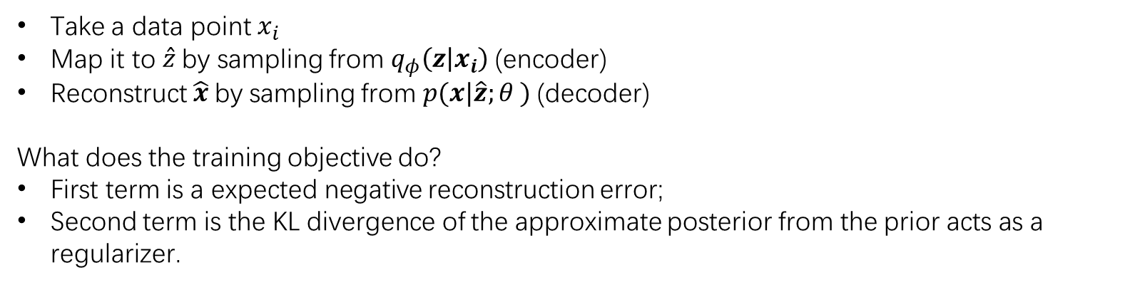
Variational Auto-Encoder
Take a data point $x_{i}$
Map it to $\hat{z}$by sampling from $q_{φ}\left(z | x_{i}\right)$(encoder)
Reconstruct $\hat{x}$by sampling from $p(x|\hat{z};θ )$(decoder)
What does the training objective do?
First term is a expected negative reconstruction error;
Second term is the KL divergence of the approximate posterior from the prior acts as a regularizer.

Slide 12
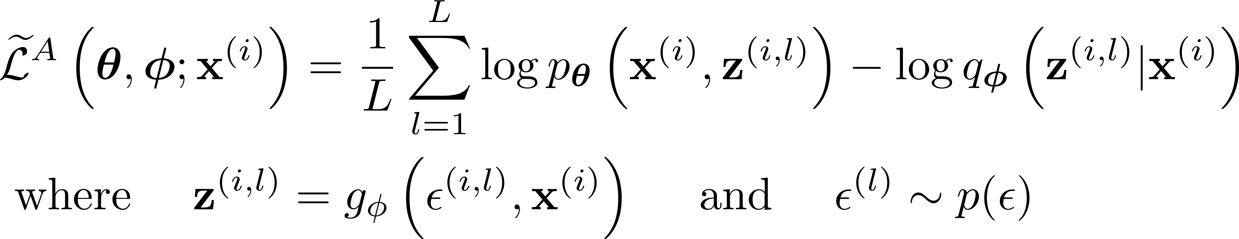
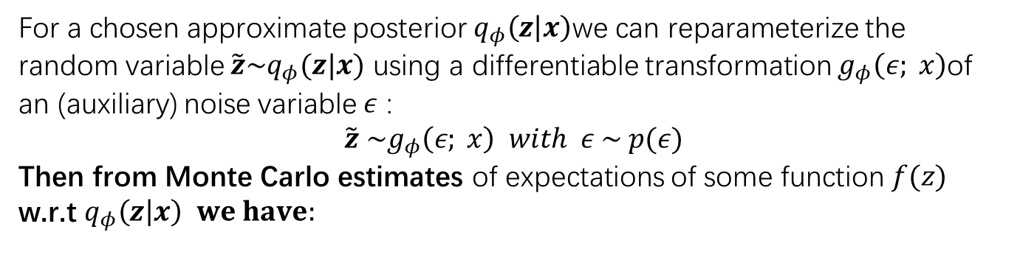
The reparameterization trick
For a chosen approximate posterior $q_{φ}\left(z | x\right)$we can reparameterize the random variable $\tilde{z}\sim q_{φ}(z|x)$ using a differentiable transformation $g_{φ}\left(ε; x\right)$of an (auxiliary) noise variable $ε$ :
$\tilde{z} \sim g_{φ}\left(ε; x\right) with ε \sim p(ε)$
Then from Monte Carlo estimates of expectations of some function $f(z)$ w.r.t $q_{φ}\left(z | x\right) we have:$
Approaches to choose such a differentiable transformation and auxiliary variable:
Tractable inverse CDF
For any ”location-scale” family of distributions we can choose the standard distribution (with location = 0, scale = 1) as the auxiliary variable
Composition: It is often possible to express random variables as different transformations of auxiliary variables.
When all three approaches fail, good approximations to the inverse CDF exist requiring computations with time complexity comparable to the PDF

Slide 13
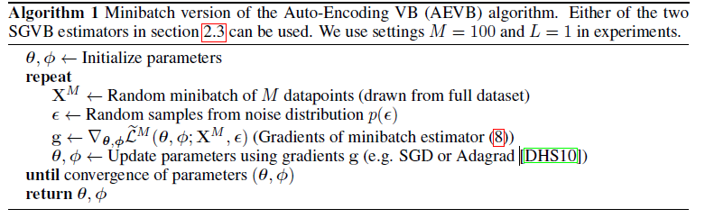
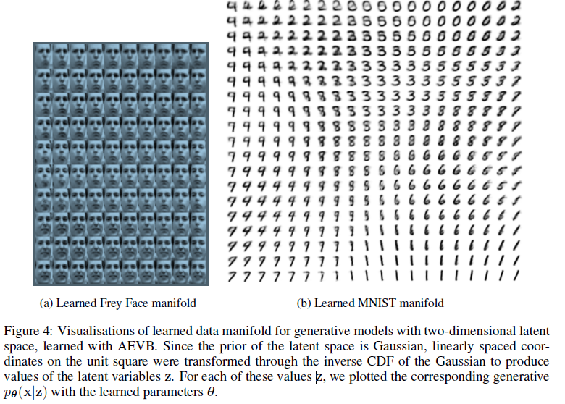
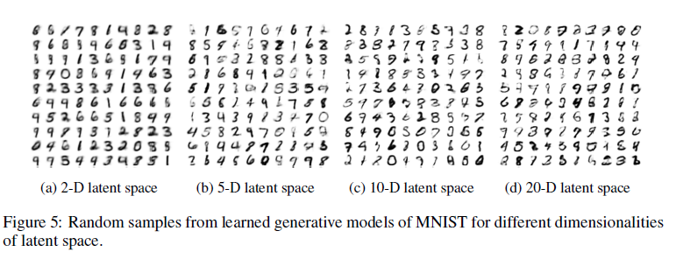
The algorithm and experiments

Slide 14
Research Direction
Better optimization techniques
More expressive approximating families
Encoder: Amortization (Gershman & Goodman, 2015; Kingma; Rezende; ..)
Augmenting variational posteriors(Monte Carlo methods, Normalizing flows, etc.)
Decoder: Powerful decoders p(xjz; ) such as DRAW (Gregor et al., 2015), PixelCNN (Gulrajani et al., 2016)
Parameterized, learned priors p(z; ) (Nalusnick et al., 2016, Tomczak & Welling, 2018, Graves et al., 2018)
Alternate loss functions
Alternatives to the reverse-KL divergence: Renyis alpha-divergences (Li & Turner, 2016), Integral probability metrics such as maximum mean discrepancy, Wasserstein distance (Dziugaite et al., 2015; Zhao et. al, 2017; Tolstikhin et al., 2018)

Slide 15
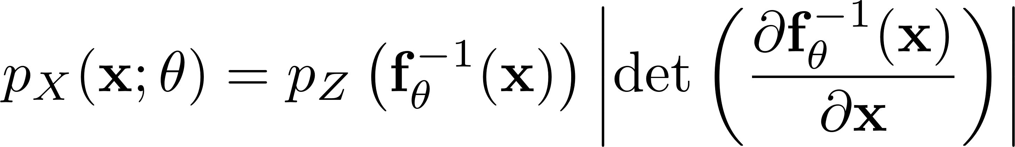
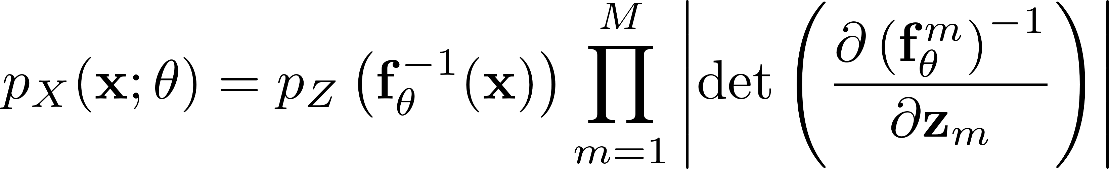
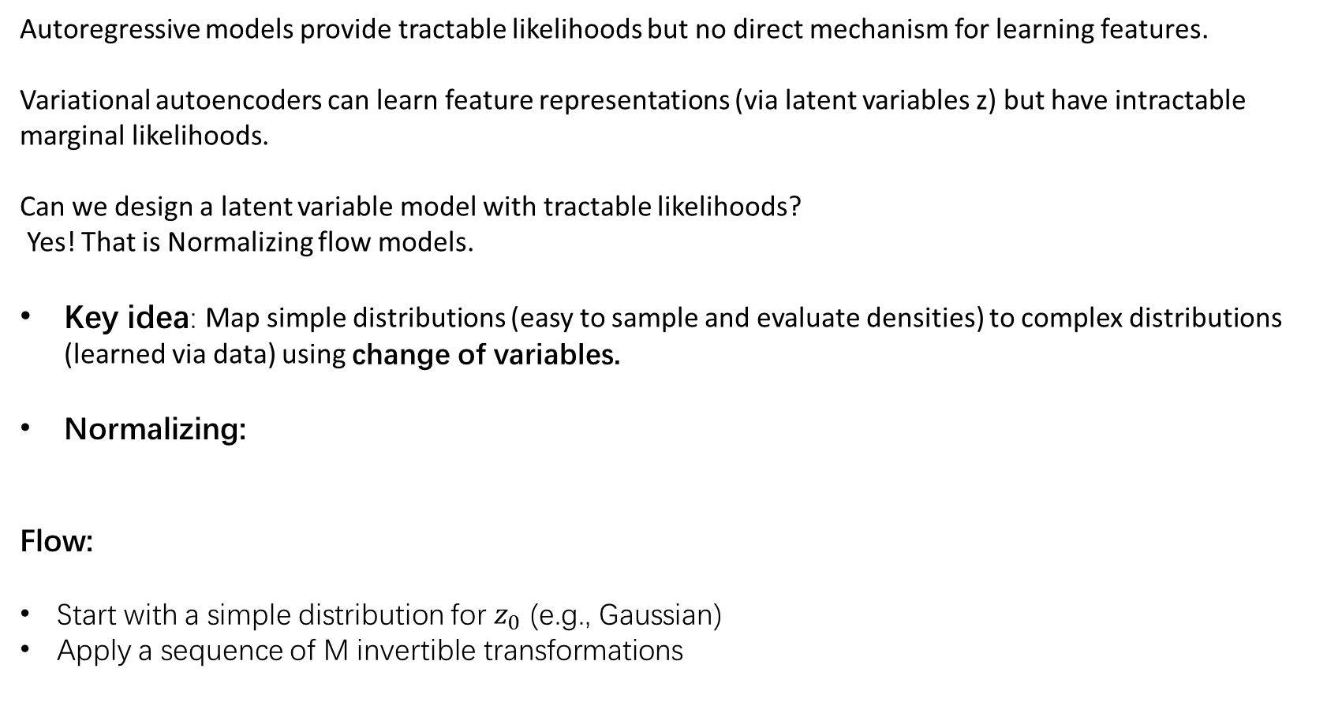
Normalizing flow models
Autoregressive models provide tractable likelihoods but no direct mechanism for learning features.
Variational autoencoders can learn feature representations (via latent variables z) but have intractable marginal likelihoods.
Can we design a latent variable model with tractable likelihoods?
Yes! That is Normalizing flow models.
Key idea: Map simple distributions (easy to sample and evaluate densities) to complex distributions (learned via data) using change of variables.
Normalizing:
Flow:
Start with a simple distribution for $z_{0}$ (e.g., Gaussian)
Apply a sequence of M invertible transformations

Slide 16
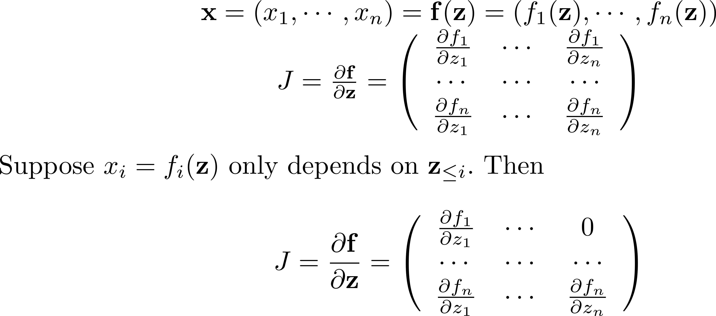
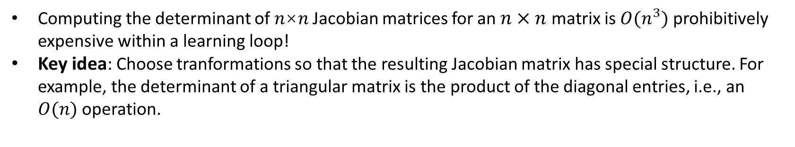
Normalizing flow models
Computing the determinant of 𝑛×𝑛 Jacobian matrices for an $n×n$ matrix is $O(n^{3})$ prohibitively expensive within a learning loop!
Key idea: Choose tranformations so that the resulting Jacobian matrix has special structure. For example, the determinant of a triangular matrix is the product of the diagonal entries, i.e., an $O(n)$operation.

Slide 17
Designing invertible transformations
Real-NVP (Dinh et al., 2017)
Glow Generative Flow with Invertible 1×1 Convolutions (Diederik et al., 2018)
Inverse Autoregressive Flow (Kingma et al., 2016)
Masked Autoregressive Flow (Papamakarios et al., 2017)

Slide 18
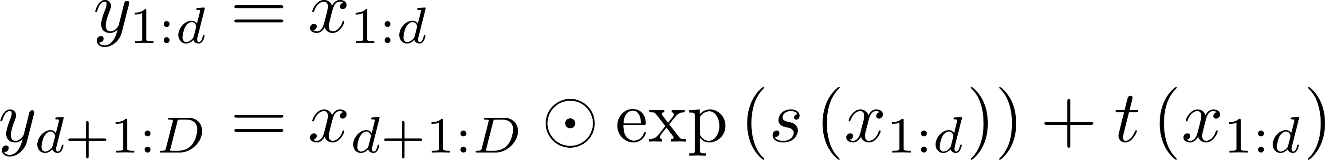
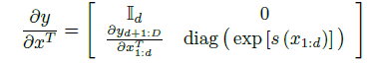
Real-NVP
affine coupling layer:
where s and t stand for scale and translation, x is a D-dimension input and d<D.
The Jacobian of this transformation does not involve computing the Jacobian of s or t:
Computing the inverse is no more complex than the forward propagation:
meaning that sampling is as efficient as inference for this model.
Notes:
Given the observation that this Jacobian is triangular, we can efficiently compute
its determinant as exp. Since computing the Jacobian determinant of the coupling
layer operation does not involve computing the Jacobian of s or t, those functions can be arbitrarily
complex.

Slide 19
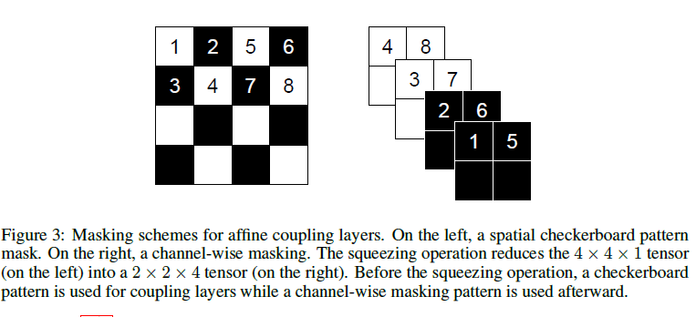
Real-NVP
Masked Convolution using a binary mask b:
Spatial checkerboard patterns: mask has value 1 where the sum of spatial coordinates is odd, and 0 otherwise.
channel-wise mask: b is 1 for the first half of the channel dimensions and 0 for the second half.
Notes:
Given the observation that this Jacobian is triangular, we can efficiently compute
its determinant as exp. Since computing the Jacobian determinant of the coupling
layer operation does not involve computing the Jacobian of s or t, those functions can be arbitrarily
complex.

Slide 20
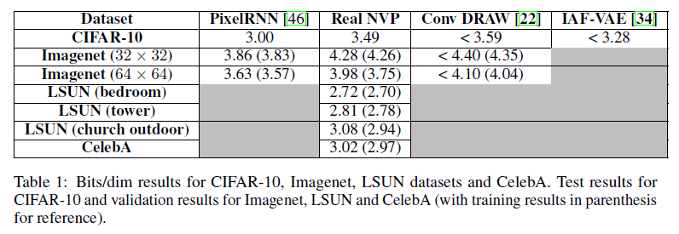
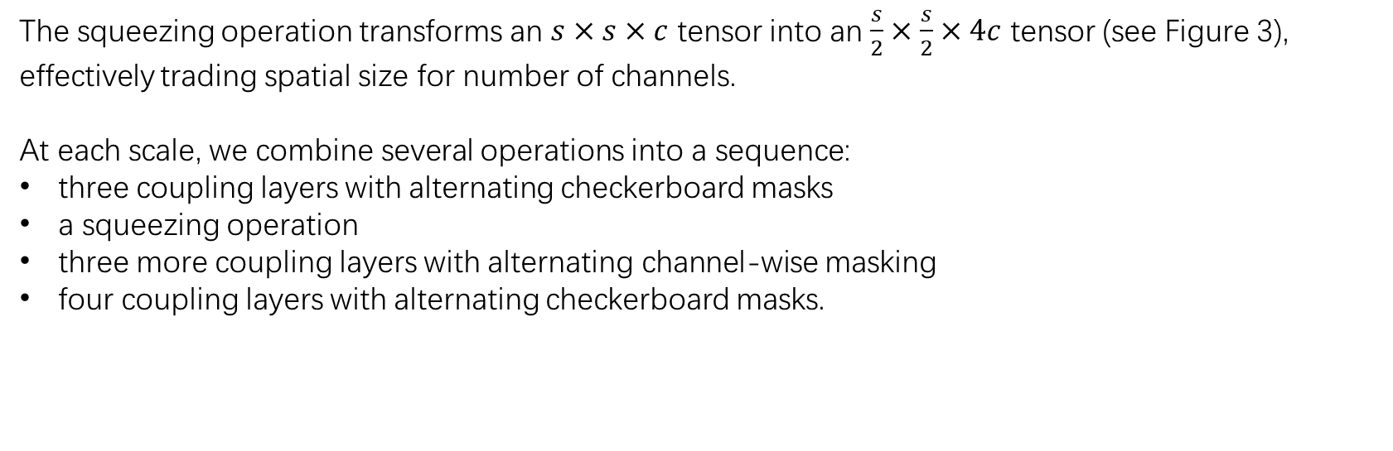
Multi-scale architectrue
The squeezing operation transforms an $s×s×c$ tensor into an $\frac{s}{2}×\frac{s}{2}×4c$ tensor (see Figure 3),
effectively trading spatial size for number of channels.
At each scale, we combine several operations into a sequence:
three coupling layers with alternating checkerboard masks
a squeezing operation
three more coupling layers with alternating channel-wise masking
four coupling layers with alternating checkerboard masks.
Notes:
Given the observation that this Jacobian is triangular, we can efficiently compute
its determinant as exp. Since computing the Jacobian determinant of the coupling
layer operation does not involve computing the Jacobian of s or t, those functions can be arbitrarily
complex.

Slide 21
Experiments and results
Notes:
Given the observation that this Jacobian is triangular, we can efficiently compute
its determinant as exp. Since computing the Jacobian determinant of the coupling
layer operation does not involve computing the Jacobian of s or t, those functions can be arbitrarily
complex.

Slide 22
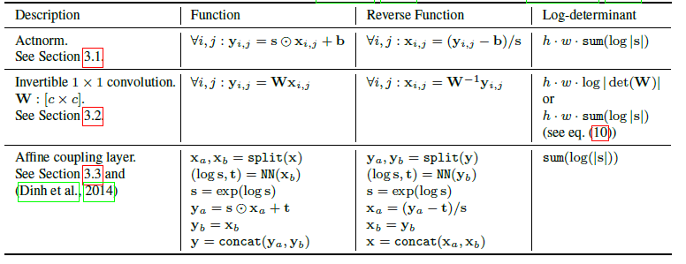
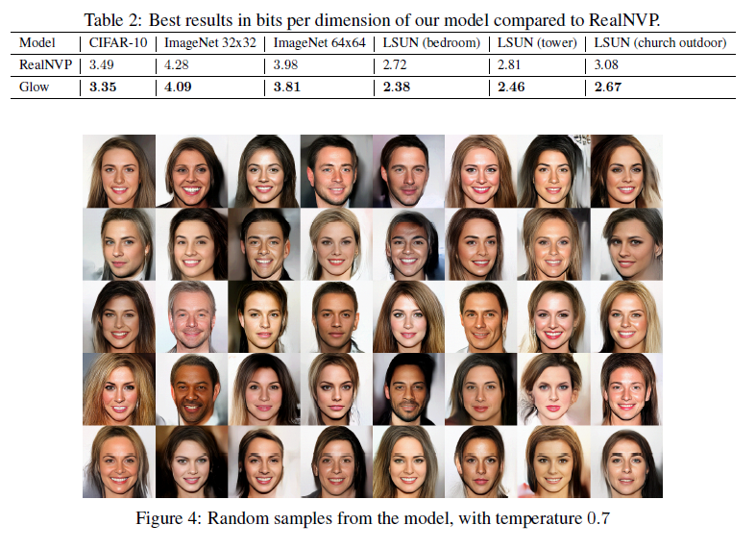
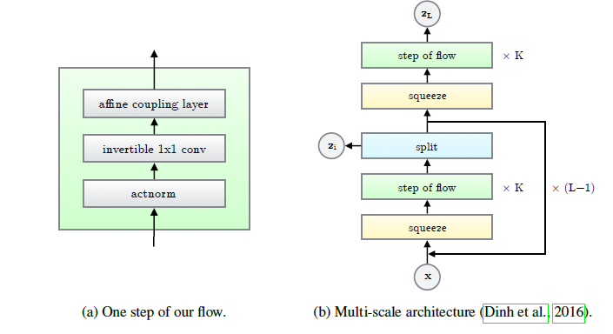
Glow Generative Flow
Notes:
1*1 convolution with equal number of input and output channels is a generalization of a permutation operation.

